Slide 1
Linear Algebra
Lecture 18

Slide 2
Determinants

Slide 3
Properties of
Determinants

Slide 4
Theorem
Let A be a square matrix.
If a multiple of one row of A is added to another row to produce a matrix B, then det B = det A.
…..

Slide 5
Continued
If two rows of A are interchanged to produce B,
then det B = –det A.
If one row of A is multiplied by k to produce B, then
det B = k det A.

Slide 6
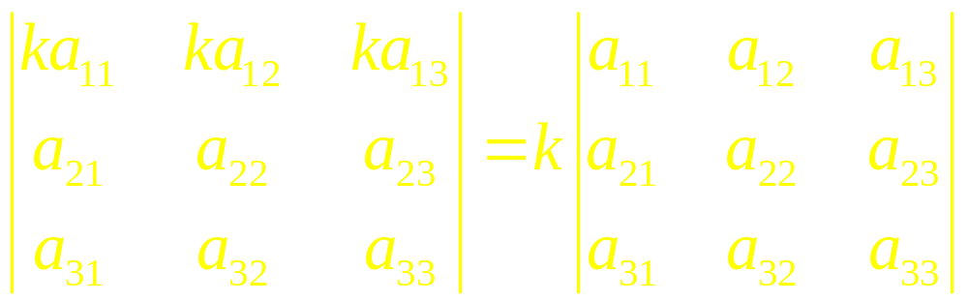
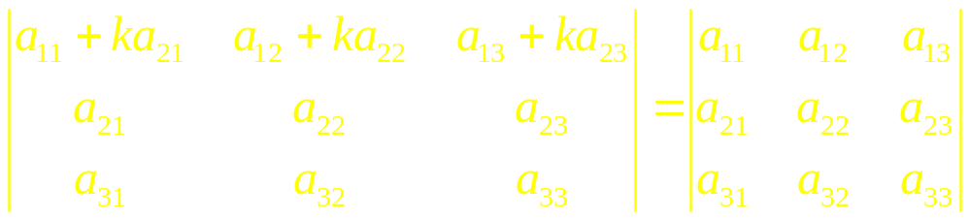
Example

Slide 7
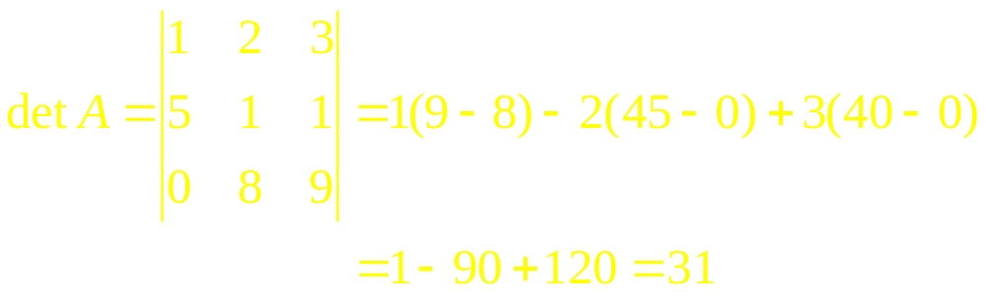
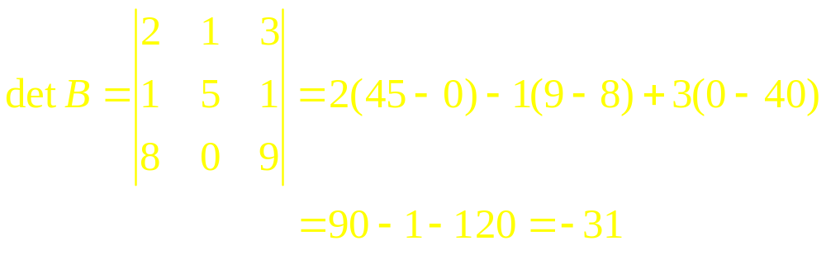
Example 1

Slide 8
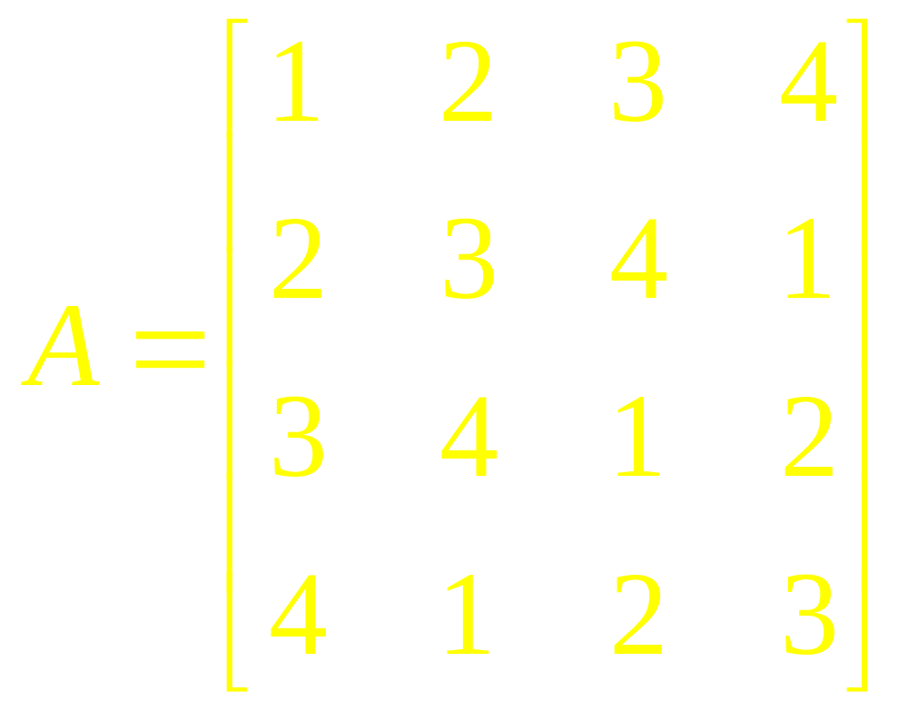
Example 2
Evaluate det A where

Slide 9
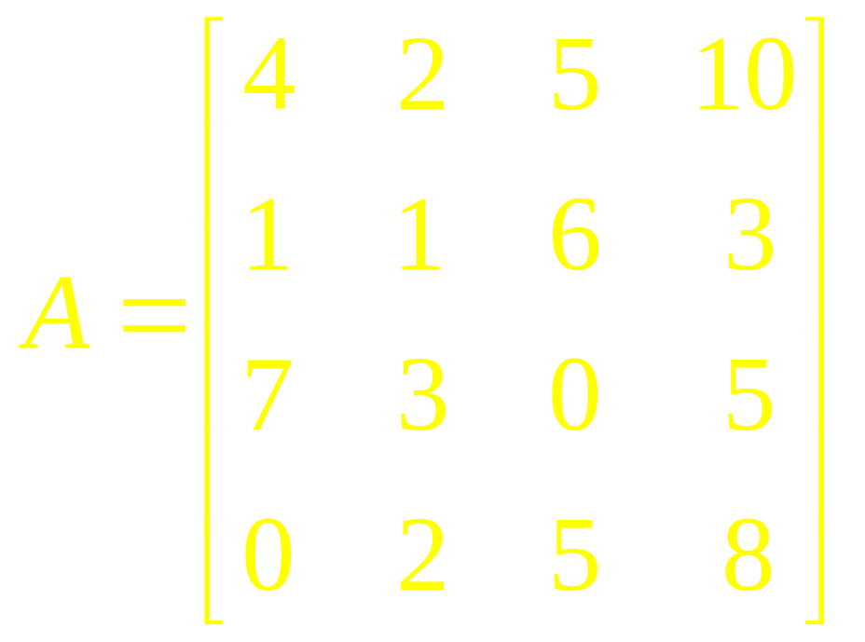
Example 3
Evaluate the determinant of the matrix

Slide 10
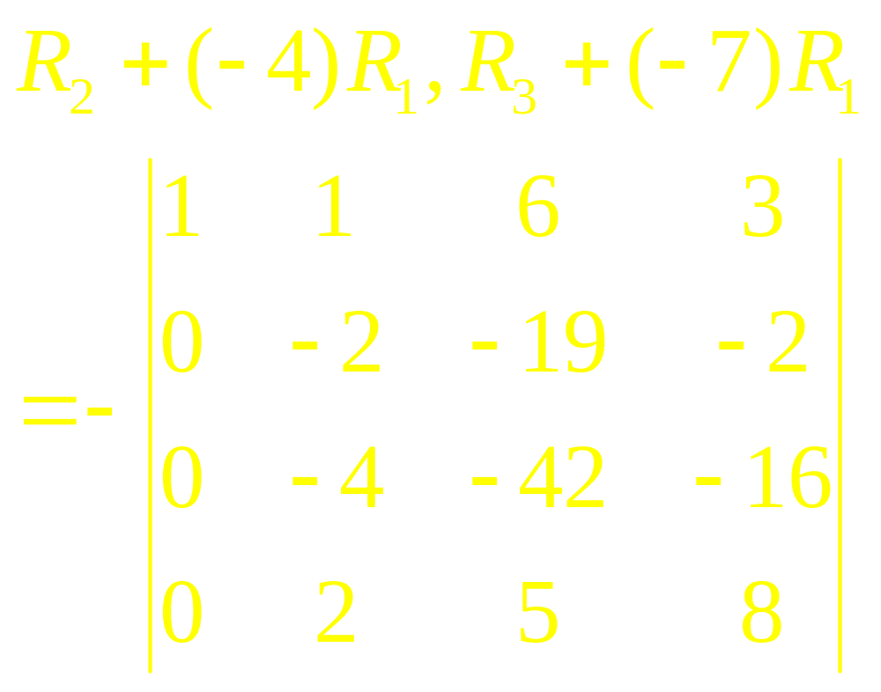
Example 3

Slide 11
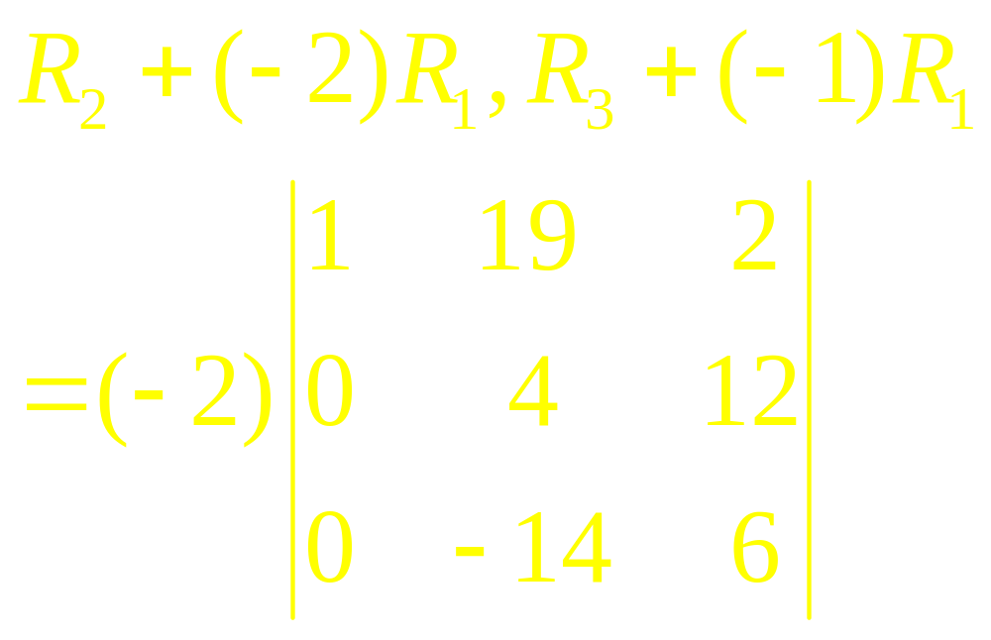
Example 3

Slide 12
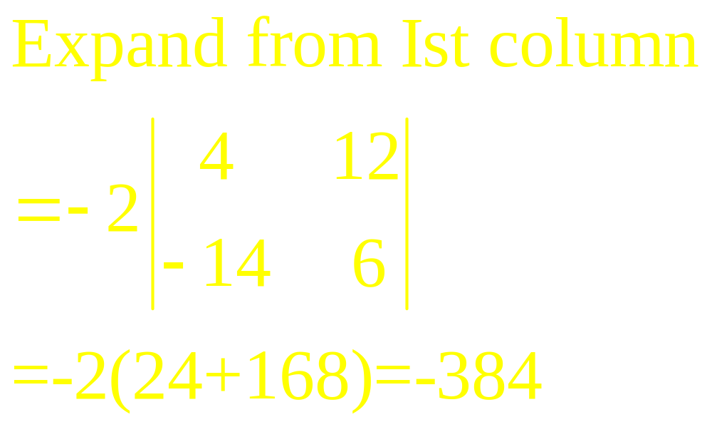
Example 3

Slide 13
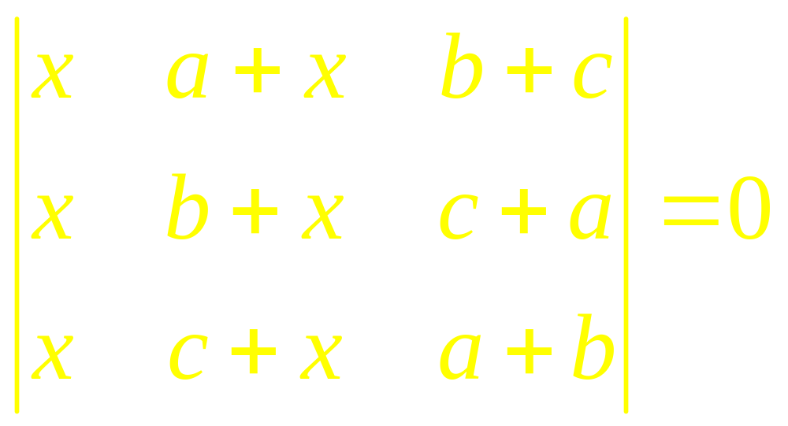
Example 4
Without expansion, show that

Slide 14
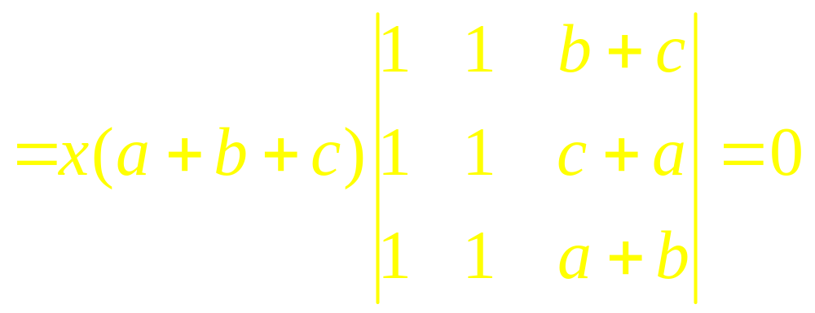
Example 4

Slide 15
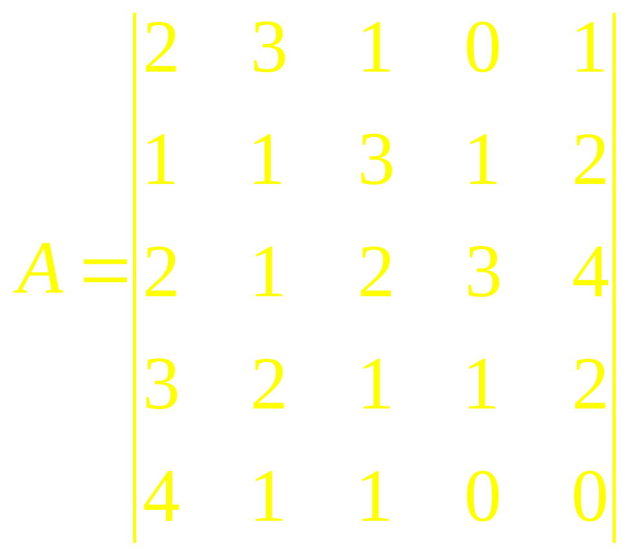
Example 5
Evaluate

Slide 16
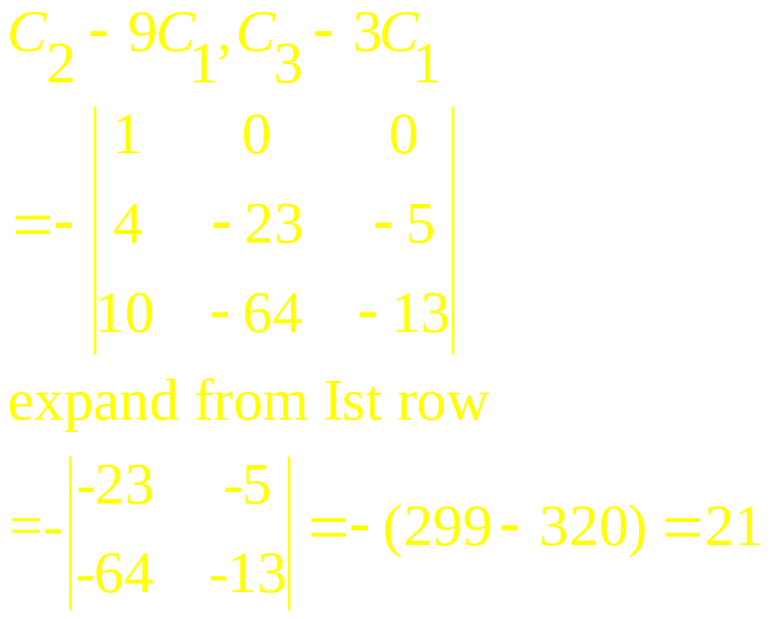
Example 5

Slide 17
An Algorithm to Evaluate the Determinant
1. By an interchange of rows of A (and taking the resulting sign into account) bring a non zero entry to (1,1) the position (unless all the entries in the first column are zero in which case det A=0).

Slide 18
2. By adding suitable multiples of the first row to all the other rows, reduce the (n-1) entries, except (1,1) in the first column, to 0. Expand det(A) by its first column. Repeat this process. Or continue the following steps.

Slide 19
3. Repeat step 1 and step 2 with the last remaining rows concentrating on the second column.
4. Repeat step 1,step2 and step 3 with the remaining (n-2) rows, (n-3) rows and so on, until a triangular matrix is obtained.

Slide 20
5. Multiply all the diagonal entries of the resulting triangular matrix and then multiply it by its sign to get det(A).

Slide 21
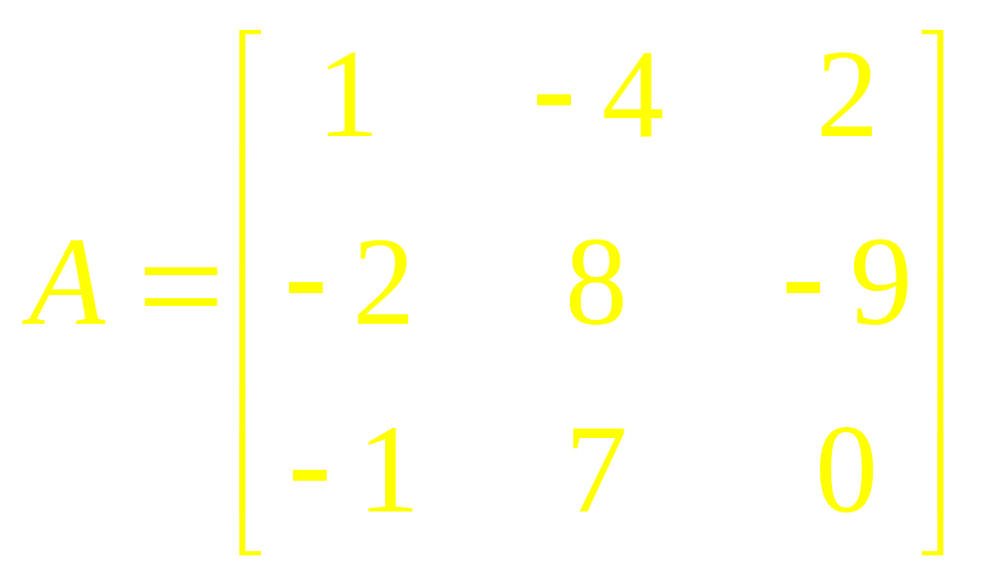
Example 6
Compute det A, where

Slide 22
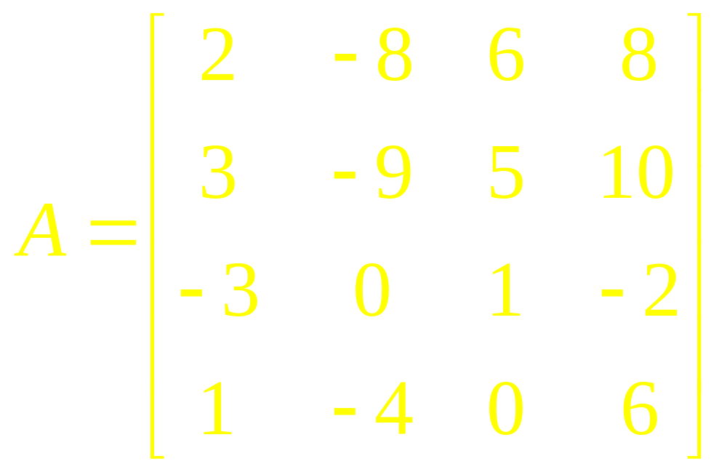
Example 7
Compute det A, where

Slide 23
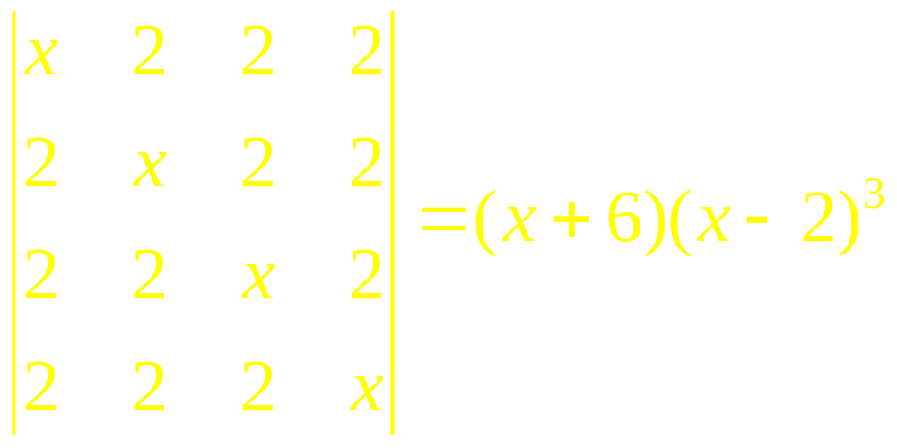
Example 8
Show that

Slide 24
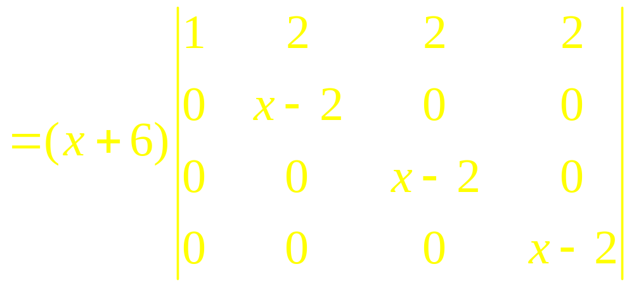
Example 8

Slide 25

Remarks
Suppose that a square matrix A has been reduced to an echelon form U by row replacements and row interchanges. If there are r interchanges, then

Slide 26
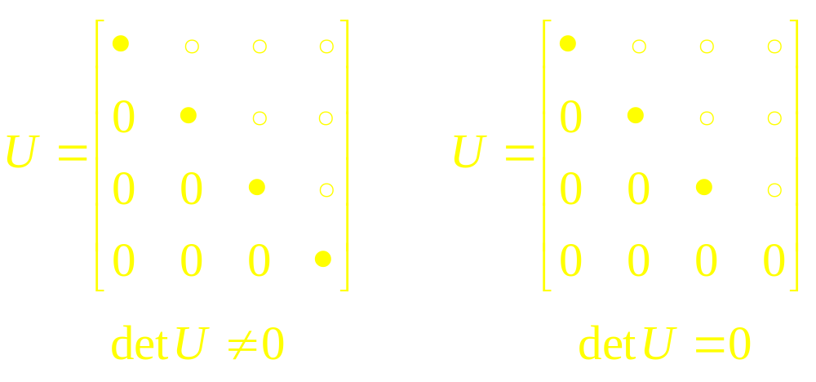
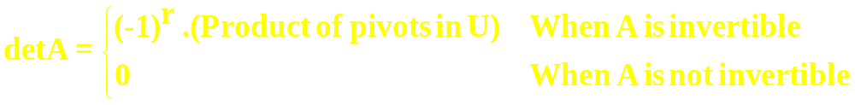
(Typical echelon forms of the square matrices)

Slide 27
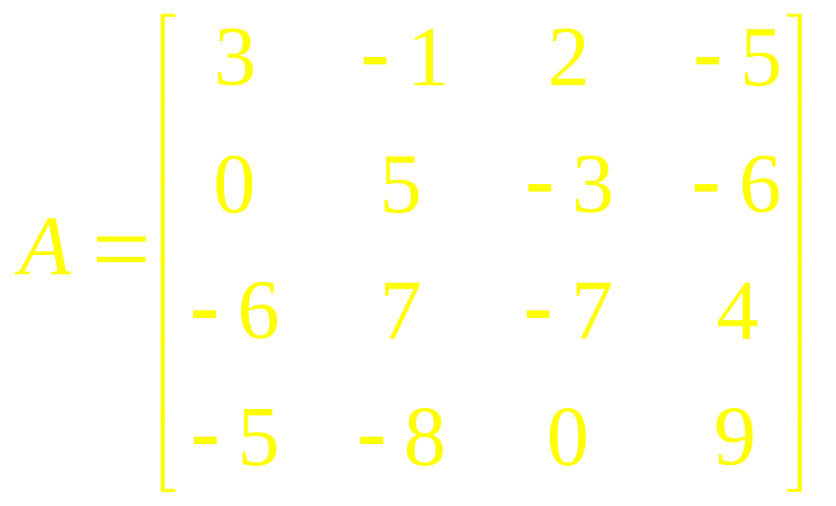
Example 9
Compute det A, where

Slide 28
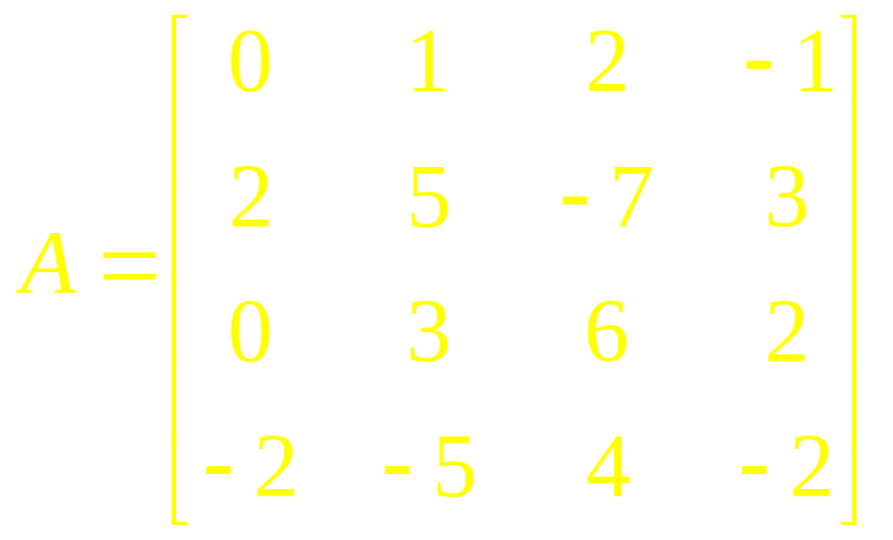
Example 10
Compute det A, where

Slide 29
Theorem
If A is an n x n matrix, then
det A^{T} = det A.
Note: We can perform operations on the columns of a matrix in a way analogous to the row operations we have considered.

Slide 30
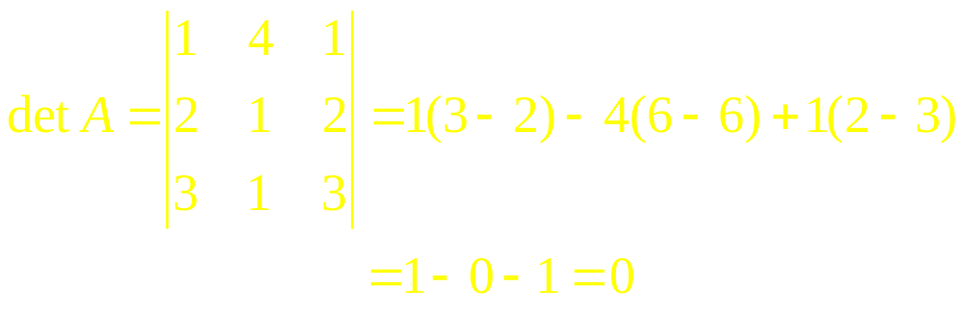
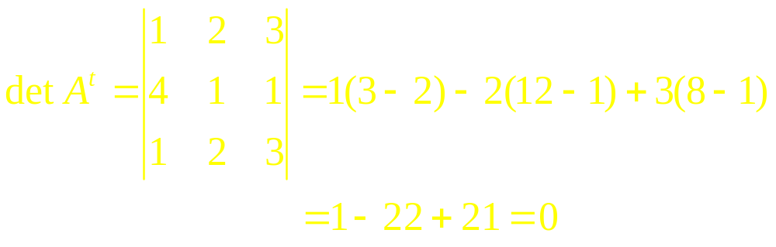
Example 11

Slide 31

Theorem
If A and B are n x n matrices, then

Slide 32
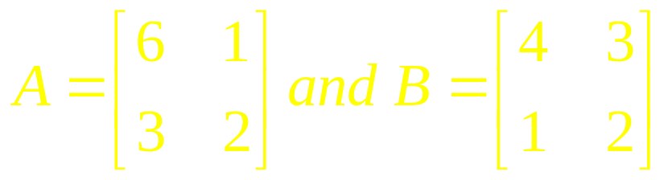
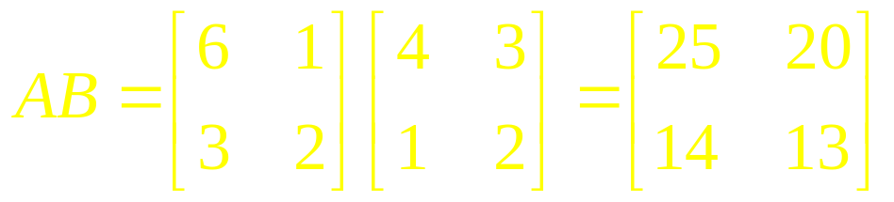
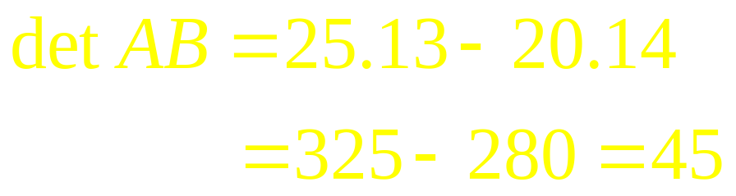
Example 12

Slide 33
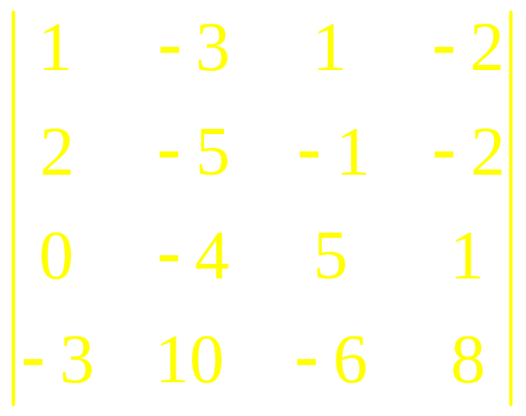
Example 13
Compute the following determinant in as few steps as possible.

Slide 34
Linear Algebra
Lecture 18

